Slide 1




DATASET & GOAL INTRODUCTION PRESENTATION FOR:
ARTIFICIAL INTELLIGENCE PROJECT (ARTIFIN)
EXTREME WEATHER-RELATED EVENTS RISK ALERT SYSTEM FOR HEALTHCARE FACILITIES IN TANZANIA.
ML BASED SYSTEM
Presentation by Belinda Mziray
HSLU | 24.02.2026

Slide 2
ARTIFICIAL INTELLIGENCE PROJECT (ARTIFIN)
OUTLINE:
INTRODUCTION : PROJECT GOAL
DATA SOURCES
FEATURE ENGINEERING
MODELING APPROACH
SYSTEM OUTPUT: FROM MODEL
INITIAL ROADMAP
CHALLENGES & OPPORTUNITIES
CONCLUSION
REFERENCES

Slide 3

INTRODUCTION
PROJECT GOAL
Facility-Level Risk Alert
OUTPUT DESIGN
Combine static geographic data (terrain, facility location) with dynamic climate signals (rainfall, soil moisture) to flag healthcare facilities at risk of weather-related disruption — as a near-real-time or seasonal alert layer.
Ternary Alert
High/Med/Low threshold flags

Slide 4




ARTIFICIAL INTELLIGENCE PROJECT (ARTIFIN)
DATA SOURCES
Healthsites.io
CHIRPS
COPERNICUS: ERA5 – LAND
COPERNICUS: Global DEM
~6,700 facilities in Tanzania
Lat / Lon coordinates
Facility type (hospital, clinic, dispensary)
Open source & regularly updated
Soil Moisture
1950 – near real-time
Layer 1 – 4 soil coverage.
Daily rainfall (5km res.)
1981 – near real-time.
The DYNAMIC SIGNAL
The STATIC RISK
The DYNAMIC SIGNAL
Slope calculation per facility
Steep = landslide risk
Low-lying = flood accumulation risk

Slide 5
FEATURE ENGINEERING
BUILDING COMPOUND RISK FEATURES
DYNAMIC FEATURES
STATIC FEATURES
CHIRPS v3 → 3-day accumulated rainfall (R3)
ERA5 Land → 7-day mean topsoil moisture (SM7)
Rainfall × soil moisture interaction.
SRTM slope at facility location (°)
Facility Location: Lat / Long
Facility type (hospital / clinic / dispensary)

Slide 6
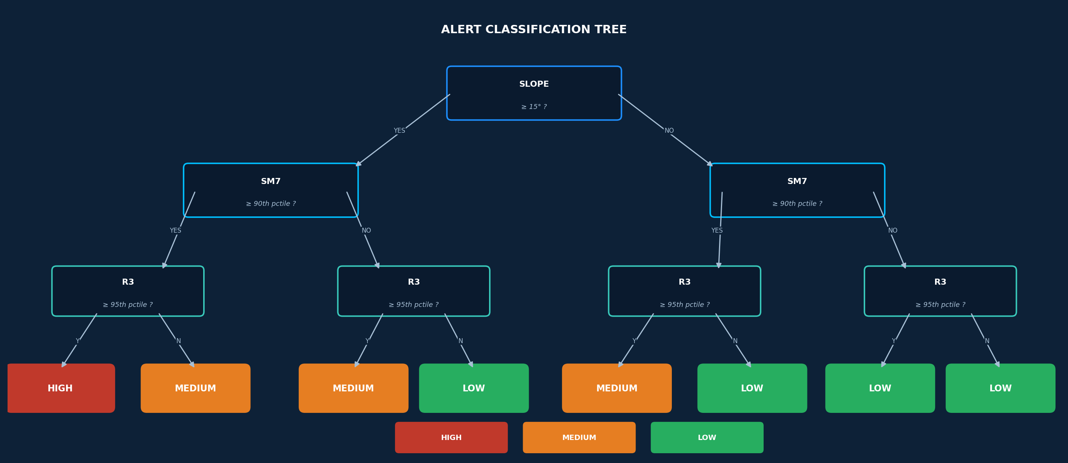
ARTIFICIAL INTELLIGENCE PROJECT (ARTIFIN)
SECTION 2 · MODELING
MODEL SELECTION: CLASSIFICATION

Slide 7
FEATURE ENGINEERING
BUILDING COMPOUND RISK FEATURES
ALERT THRESHOLDS
Rainfall Threshold
Extreme Rain Event
R3 ≥ 95th percentile (local baseline)
Soil Moisture Threshold
Saturated Ground Condition
SM7 ≥ 90th percentile
Terrain Conditioning
Steep Terrain Flag
Slope ≥ 15°

Slide 8
SYSTEM OUTPUT
WHAT THE ALERT SYSTEM WOULD LOOK LIKE:
HIGH
Slope ≥ 15° AND R3 ≥ 95th percentile AND SM7 ≥ 90th percentile
→ Very high surface runoff → Flash flooding risk → High probability of slope failure near facility → Likely service disruption
Immediate action required. Pre-position supplies, notify district health officer.
R3 ≥ 95th percentile AND SM7 ≥ 90th percentile
Slope ≥ 15° AND R3 ≥ 95th percentile
→ High runoff generation → Possible road inaccessibility → Increased landslide susceptibility in steep areas
Monitor closely. Prepare contingency plan and verify road access status.
MEDIUM
LOW
R3 < 95th percentile
SM7 < 90th percentile
→ Low runoff efficiency → Minimal facility access disruption risk
Normal operations. Continue routine monitoring via dashboard.

Slide 9





ARTIFIN PRESENTATION
INITIAL ROADMAP
2
3
4
5
Data Pipeline
Feature Engineering
Modeling
Deployment
CI/CD
Initial examination of data suitability and availability.
Transform raw data into meaningful features. Normalize, encode, and select variables.
Train models on historical data, log experiments, tune hyperparameters.
Package and deploy model to production environment with monitoring.
Automate testing, integration, and delivery pipelines for continuous updates.

Slide 10









ARTIFIN PRESENTATION
IS MLOps NECESSARY?
Evaluating the case for MLOps in weather-based risk prediction
LEARNING
YES
COMPLEX PATTERNS
YES
EXISTING DATA
YES
Seasonal geographic weather patterns
Climate change impacts has baselines values but follow patterns that change.
Historical weather records available for training
PREDICTIVE
YES
UNSEEN DATA
YES
REPETITIVE
YES
Weather (X1, X2) = Risk Alert (High, Medium, Low)
Forecast based on historic data
Daily predictions run on a recurring schedule
COST OF PREDICTION
DEPENDS
SCALABILITY
YES
ADAPTABILITY
YES
Varies by infrastructure and compute requirements
Incorporates new weather data seamlessly
Model updates as environment shifts over time

Slide 11




ARTIFIN PRESENTATION
ANTICIPATED CHALLENGES IN PRODUCTION
Data Drift
Label Availability
Climate patterns shift seasonally — rainfall in March 2023 ≠ March 2025. Model must be retrained or recalibrated regularly.
No historical disruption events from MOH. Proxy labels may drift from reality over time, making performance hard to monitor.
Data Pipeline Reliability
Explainability for Stakeholders
GEE API, CHIRPS updates, and Healthsites.io can all have delays in changes.
Health officers need to trust the alert. SHAP explanations and clear confidence scores are essential for adoption.

Slide 12

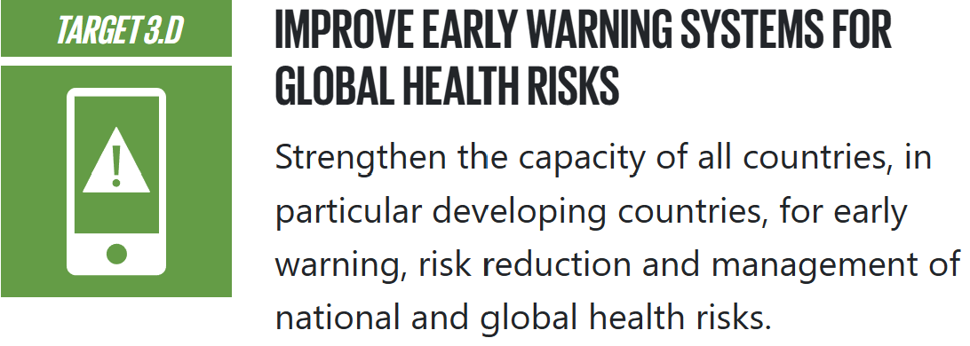

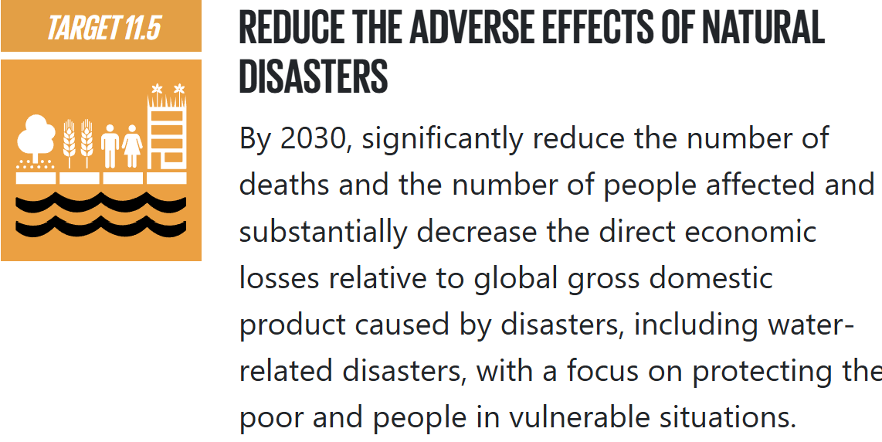
ARTIFICIAL INTELLIGENCE PROJECT (ARTIFIN)
SDG FOCUS
13.1
13.2

Slide 13
ARTIFIN PRESENTATION
References
Funk, C.C., Peterson, P.J., Landsfeld, M.F., Pedreros, D.H., Verdin, J.P., Rowland, J.D., Romero, B.E., Husak, G.J., Michaelsen, J.C., and Verdin, A.P., 2014, A quasi-global precipitation time series for drought monitoring: U.S. Geological Survey Data Series 832, 4 p. http://pubs.usgs.gov/ds/832/
Copernicus Climate Change Service / ERA5-Land. ECMWF. https://cds.climate.copernicus.eu
Healthsites.io — Global healthcare facility database. https://healthsites.io
Jarvis, A. et al., 2008. Hole-filled SRTM for the globe v4. CGIAR-CSI. https://srtm.csi.cgiar.org

Slide 14

Building Climate-Resilient
Health Systems
Facility-Level Weather Impact Risk Alert System · Tanzania
Healthsites.io · CHIRPS · ERA5-Land · SRTM · Google Earth Engine

